Slide 1


ITI bash script Project
User and Group Management System
Done by:
Mariam Said Yousef Alshikh
Supervisor:
Eng/ Romany Nagy

Slide 2
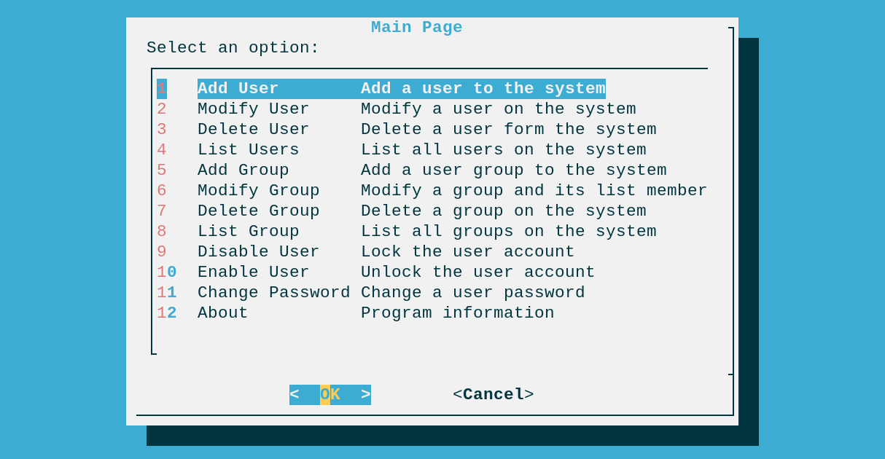
Introduction
This project is a Bash script designed to manage users and groups in Red hat operating system using Dialog, Whiptail and Cases.

Slide 3
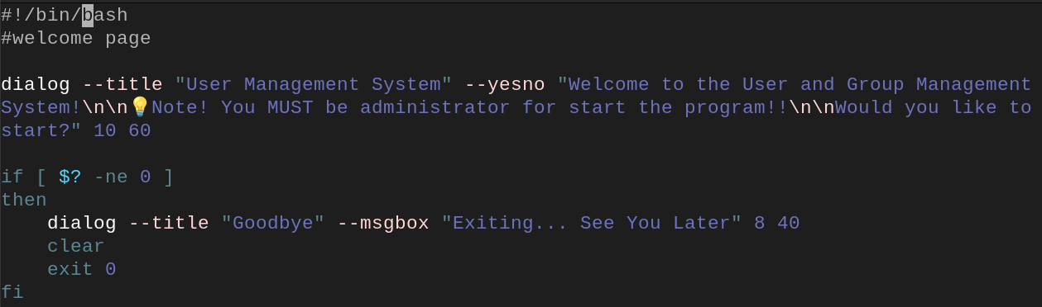
program
Program contain:
Welcome Page when started script
Greets the user with a Yes/No dialog.
If “No” → exits program.
If “Yes” → opens check administrator .

Slide 4
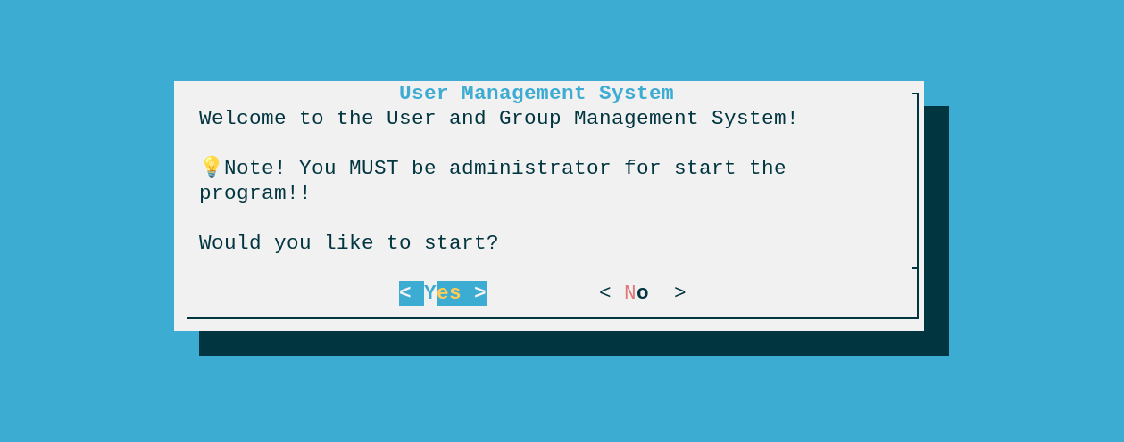
Welcome page

Slide 5

Welcome page
If click no

Slide 6
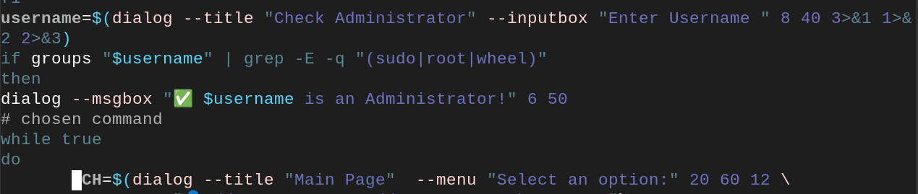
program
Program contain:
Check administrator
If “No” → exits program.
If “Yes” → open the menu .

Slide 7

Check administrator page
Enter username for check if you administrator or not

Slide 8


Check administrator page
username redhat is administrator
Enter to go to the menu

Slide 9
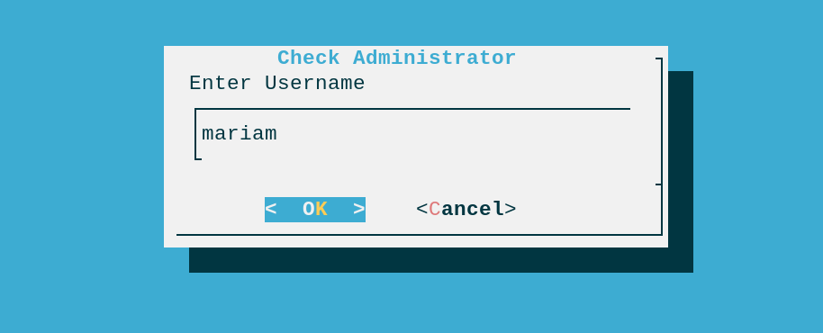
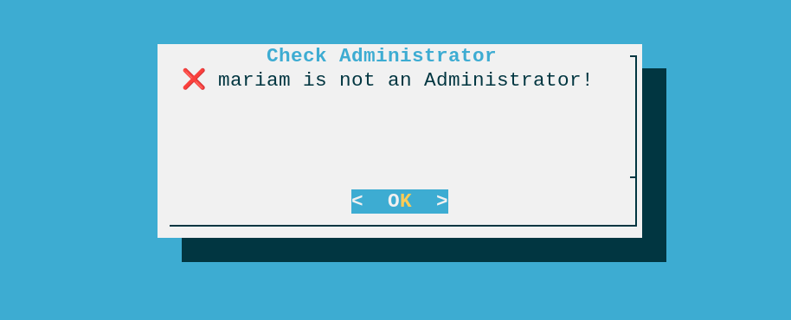
Check administrator page
username mariam is not administrator
You cannot go to the menu, and the program is exit

Slide 10
program
Program contain:
Menu for choosing option
If “1” →Add a user to the system
If ”2“→ Modify a user on the system
If ”3“→ Delete a user form the system
If ”4“→ List all users on the system
If ”5“→ Add a user group to the system
If ”6“→ Modify a group and its list members
If ”7“→ Delete a group on the system
If ”8“→ List all groups on the system
If ”9“→ Lock the user account
If ”10“→ Unlock the user account
If ”11“→ Change a user password
If ”12“→ Program information

Slide 11
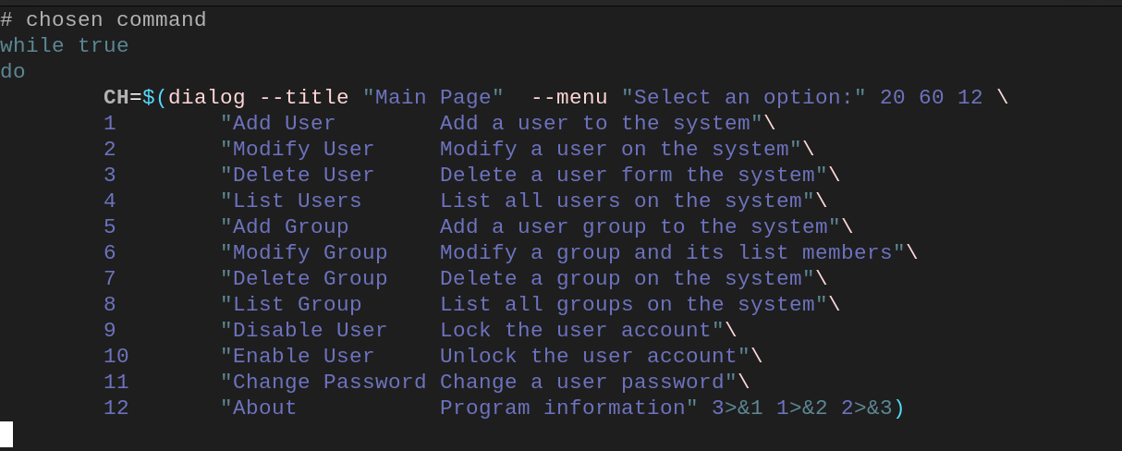
Menu

Slide 12
Menu page

Slide 13
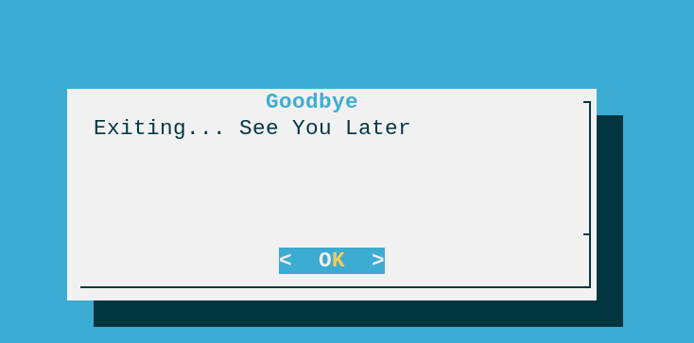
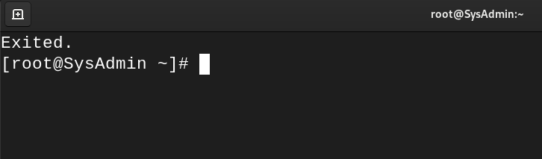
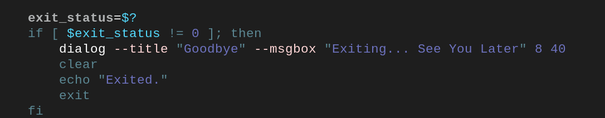
Menu
If click cancel

Slide 14
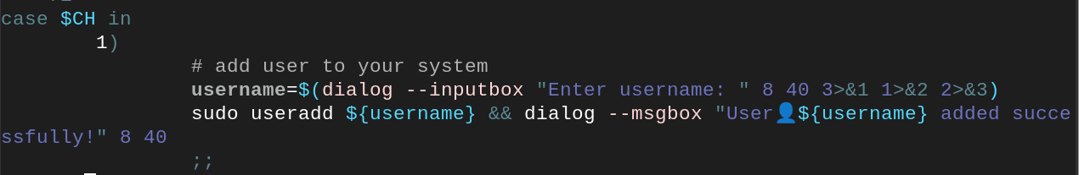
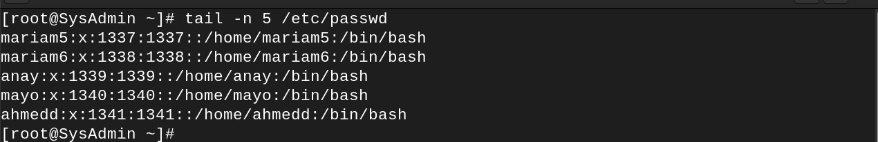
Add user
When administrator choose add user it be in case 1

Slide 15

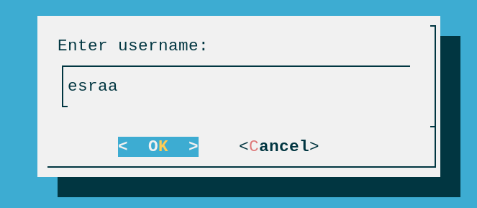
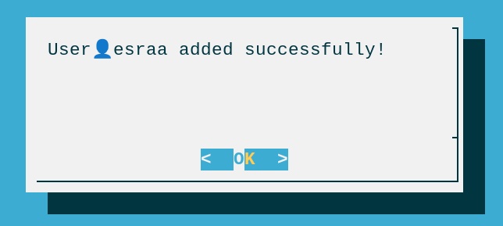
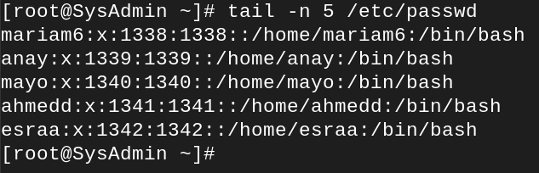
Add user
When administrator choose add user it be in case 1
User esraa added

Slide 16
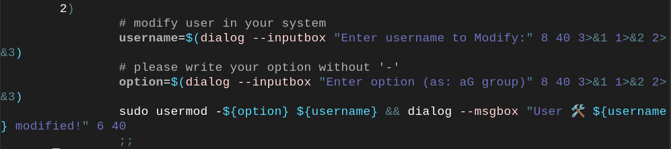
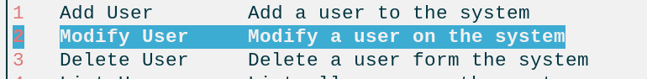
Modify user
When administrator choose modify user it be in case 2

Slide 17
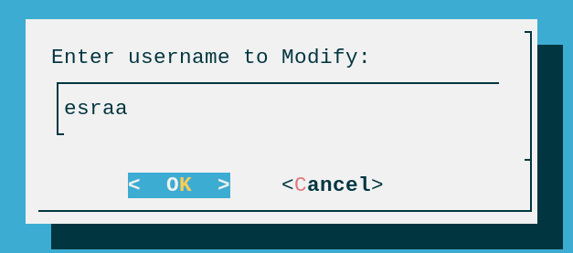
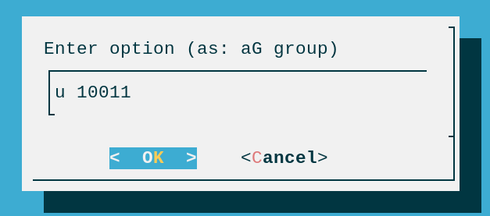
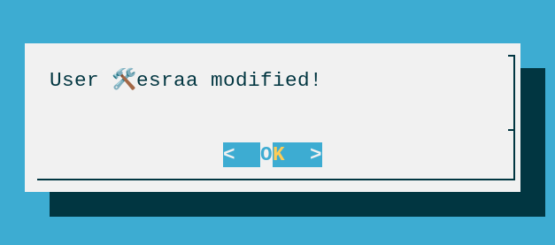
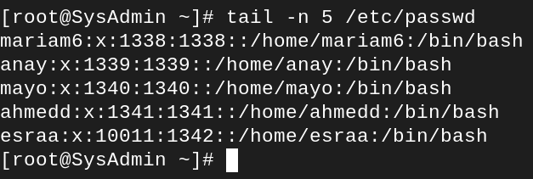
Modify user
When administrator choose modify user it be in case 2
Note that: when add option don’t put “-”

Slide 18
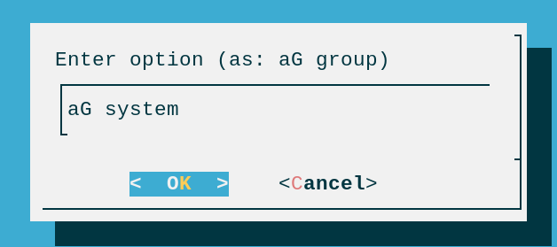
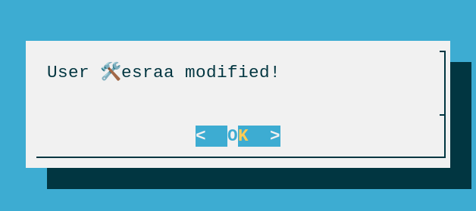
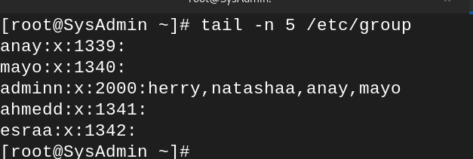
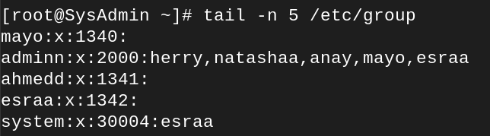
Modify user
When administrator choose modify user it be in case 2
And you can add user to group by use option aG name of group
Note that: when add option don’t put “-”

Slide 19
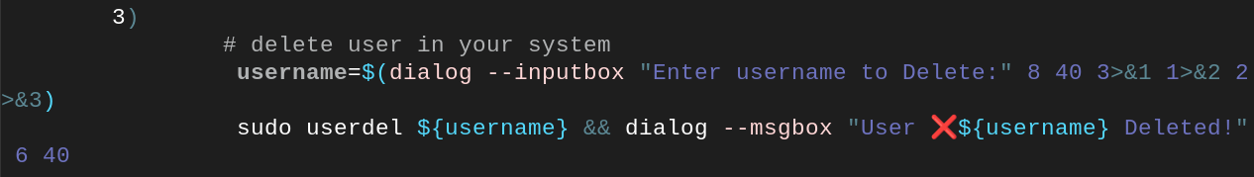
Delete user
When administrator choose delete user it be in case 3

Slide 20
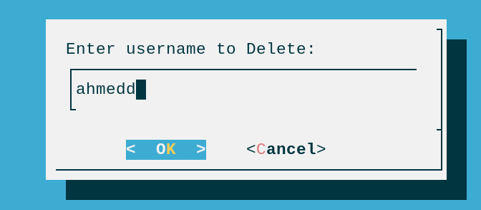

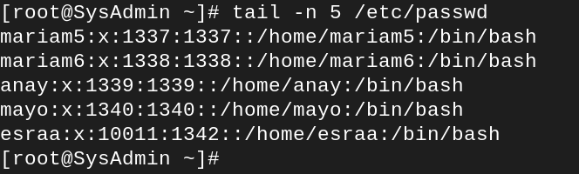
Delete user
When administrator choose delete user it be in case 3
User ahmedd deleted

Slide 21
List all users
When administrator choose list all users it be in case 4

Slide 22
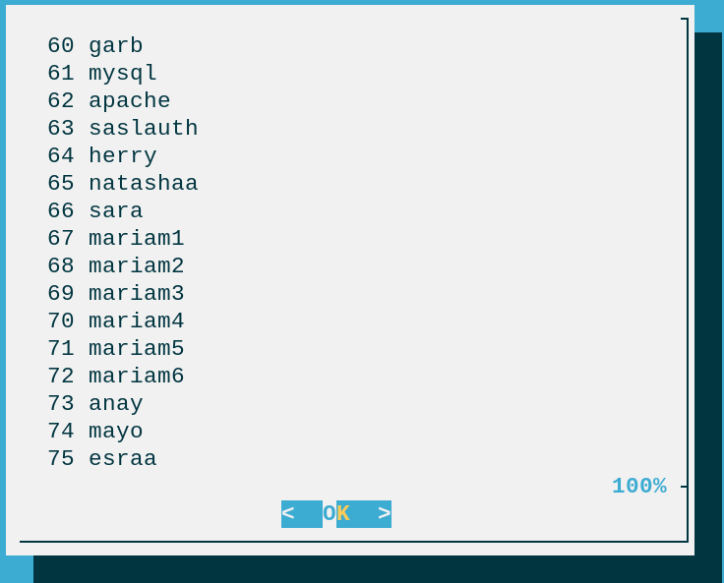
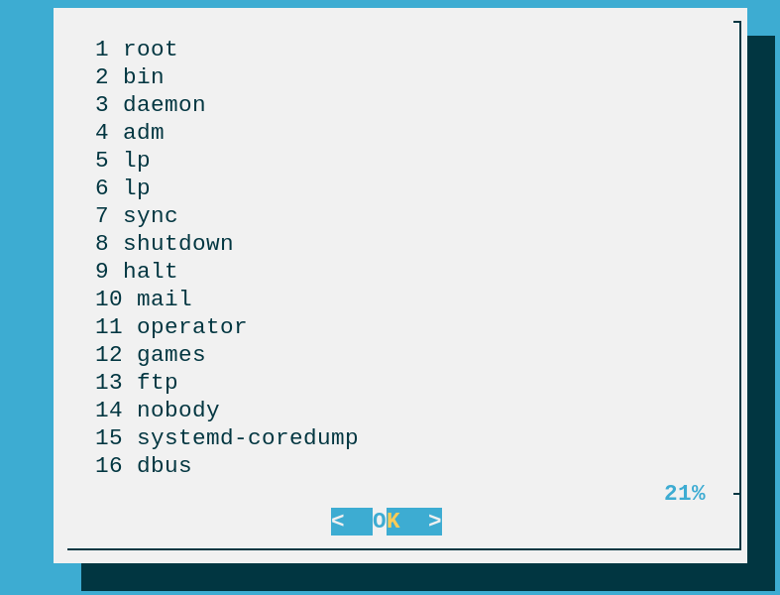
List all users
When administrator choose list all users it be in case 4

Slide 23
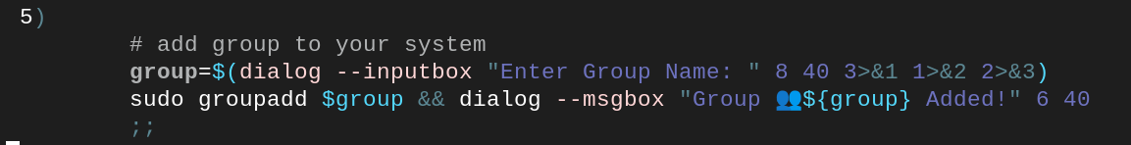
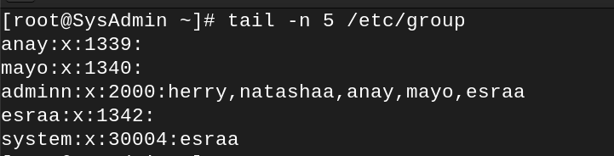
Add group
When administrator choose add group it be in case 5

Slide 24
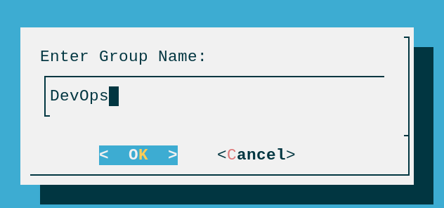

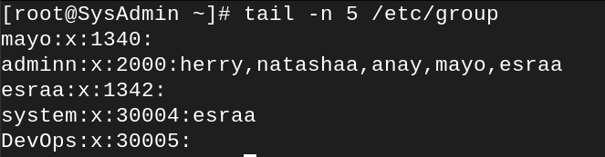
Add group
When administrator choose add group it be in case 5

Slide 25
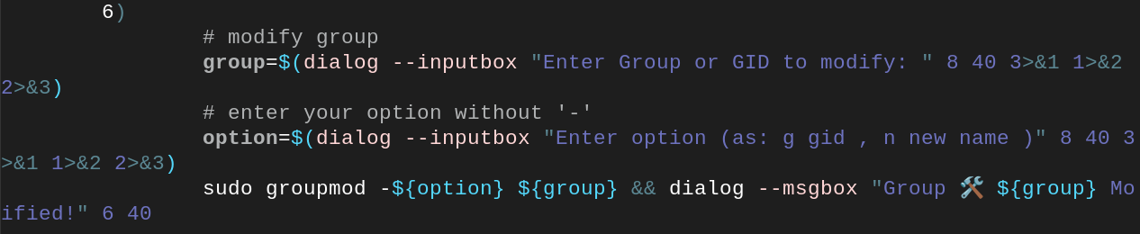
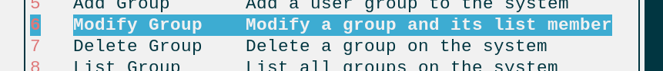
Modify group
When administrator choose modify group it be in case 6

Slide 26
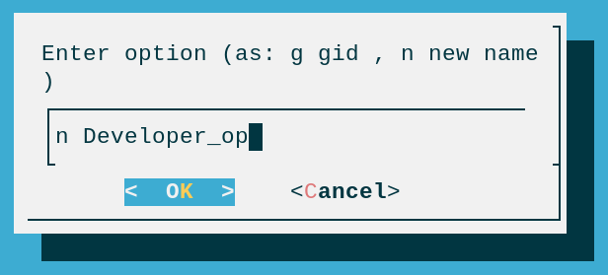
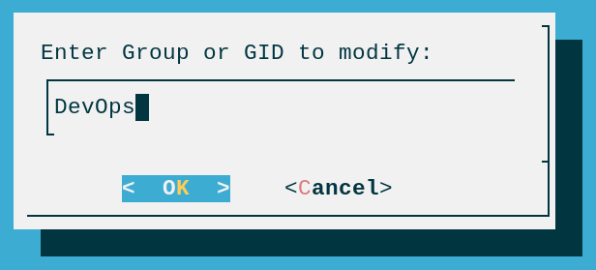
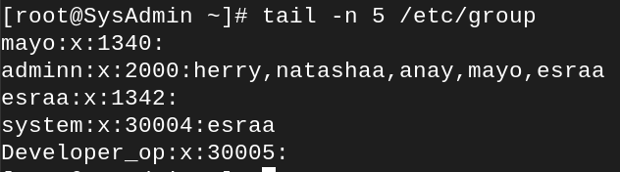

Modify group
When administrator choose modify group it be in case 6
n option for change group name
Note that: when add option don’t put “-”

Slide 27
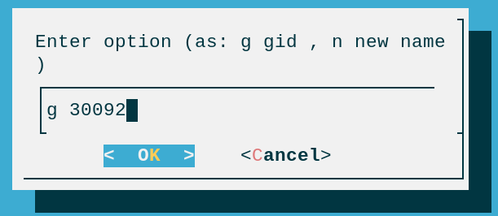
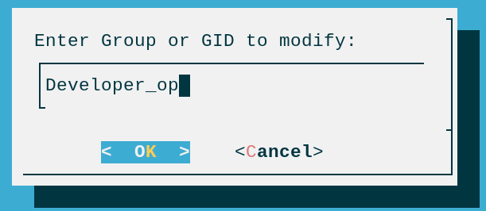

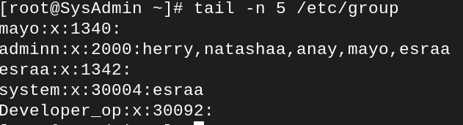
Modify group
When administrator choose modify group it be in case 6
g option for change group id

Slide 28
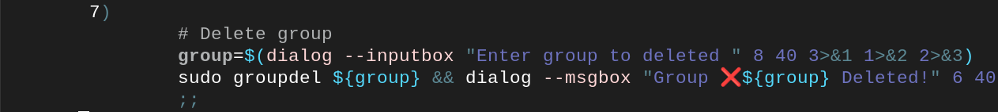
Delete group
When administrator choose delete group it be in case 7

Slide 29
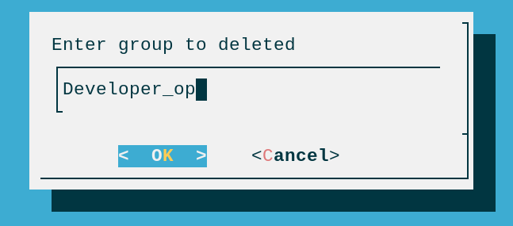

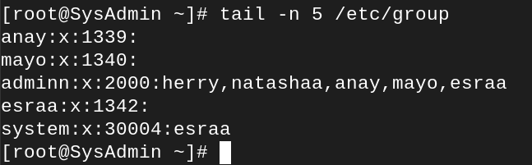
Delete group
When administrator choose delete group it be in case 7

Slide 30

List groups
When administrator choose list groups it be in case 8

Slide 31
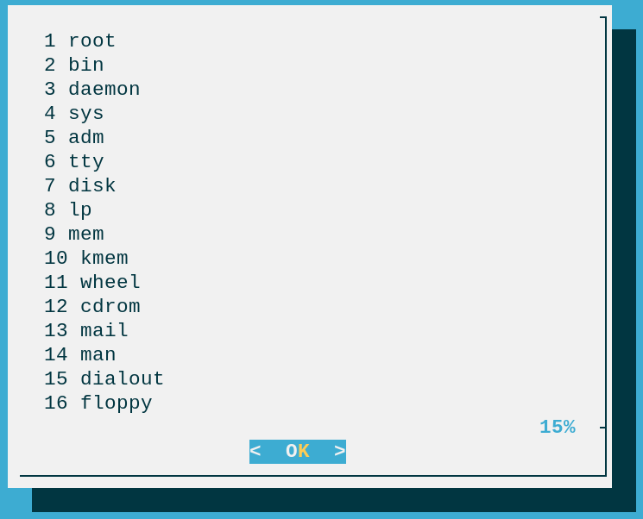
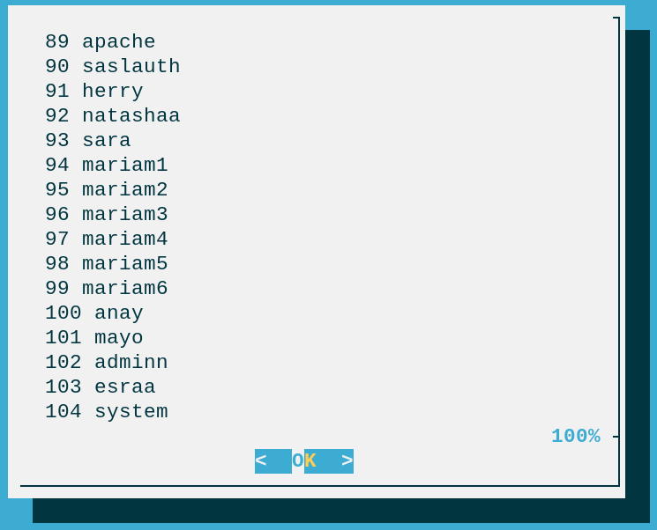
List groups
When administrator choose list groups it be in case 8

Slide 32
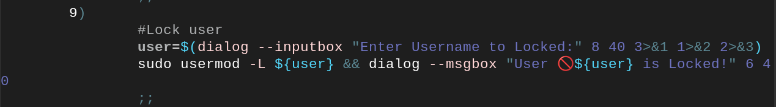
Locked user
When administrator choose locked user it be in case 9

Slide 33
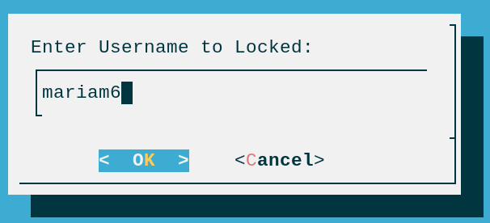
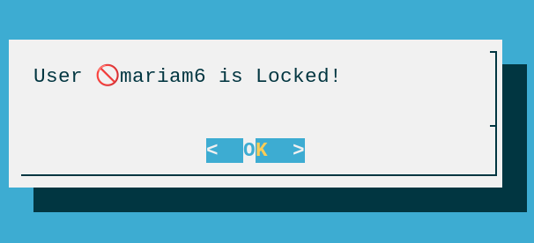
Locked user
When administrator choose locked user it be in case 9

Slide 34

Unlocked user
When administrator choose unlocked user it be in case 10

Slide 35


Unlocked user
When administrator choose unlocked user it be in case 10

Slide 36

change password
When administrator choose change password it be in case 11

Slide 37




change password
When administrator choose change password it be in case 11
Use new password in log in

Slide 38


Information about system
When administrator choose information about system it be in case 12

Slide 39

Information about system
When administrator choose information about system it be in case 12

Slide 40
The End

